Slide 1



Food
Sales report
Johan John
2024

Slide 2

Introduction
The primary objective of this report is to analyze the pizza sales data to gain valuable insights into order patterns, revenue generation, and the popularity of various pizza items.
The data for this analysis was extracted from the company's MySQL database, which stores detailed records of all pizza orders. The dataset includes information on order IDs, pizza types, sizes, prices, quantities, and timestamps of orders.
This is a SQL Quering based report wherein i have used various techniques like data extraction, data aggregation,
joins & filters, and sortinng & limiting.

Slide 3


Objectives
Analyze Order Patterns
Calculate Revenue
Identify Popular Items
Optimize Inventory and Marketing
Assumptions
Data Completeness
Consistent Pricing
Uniform Data Storage
Customer Behavior Consistency

Slide 4
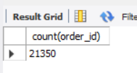
The total number of orders placed.
There are a total of 21350 orders placed as per the recent records

Slide 5
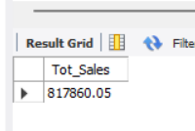
The total revenue generated from pizza sales.
The total sales of pizza as per record is 817860Rs

Slide 6
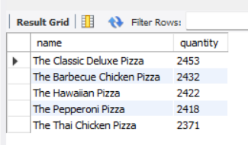
The most ordered pizza types along with their quantities.
Thus we can say that the Clasic Deluxe is the most liked pizza from the menu

Slide 7
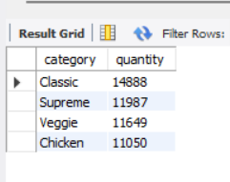
The total quantity of each pizza category ordered.
From the menu the most ordered category is the Classic type

Slide 8
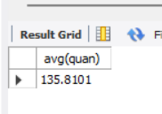
The average number of pizzas ordered per day.
Hence we can say that from the restaurant there is a average sales of 136 pizzas per day

Slide 9
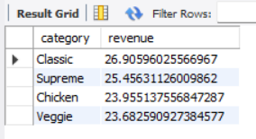
The percentage contribution of each pizza type to total revenue.
Here we can see all the contribution towards the revenue by each category

Slide 10
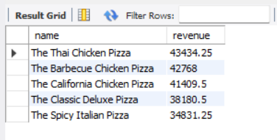
The most ordered pizza types based on revenue.
Hence we can see that Even thought the Classic ccategory had made more orders but the most revenue generator is the Thai Chicken Pizza.

Slide 11

Conclusion
The analysis revealed strong pizza demand, significant revenue, and Classic as the preferred category. Key insights include the top five ordered pizzas, peak ordering times, and category preferences. The data will guide inventory management, marketing strategies, and staffing to enhance customer satisfaction and business performance.

Slide 12




Contact
9167559187
2021.johan.john@ves.ac.in

Slide 13
Thank you!
Sandra Haro
2024

